Slide 1
Flow of Control

Slide 2
Flow of Control
Without flow of control statements, programs would always start at the main function, and perform each executable statement exactly once in order from top to bottom. Suppose you wanted to accept 10 integers from the user, add them and print the result.
Without flow of control you might have a very simple program with a lot of variables….

Slide 3
Add 10 integers entered by user.
#include <stdio.h>
int main(void)
{
int int1 , int2, int3, int4, int5, int6, int7, int8, int9, int10 ;
printf(“Enter 10 integers separated by spaces”);
scanf(“%d %d %d %d %d %d %d %d %d %d”, &int1, &int2, &int3, &int4, &int5, &int6, &int7, &int8, &int9, &int10);
printf(“Their total is: %d\n”,
int1 + int2 + int3 + int4 + int5 + int6 + int7 + int8 + int9 + int10 );
return 0;
}
OR
You might have a program with just one variable and a lot of statements.

Slide 4
Add 10 integers entered by user.
#include <stdio.h>
int main(void)
{
int total=0, UsersData ;
printf(“Enter 10 integers separated by spaces”);
scanf(“%d ”, &UsersData); total += UsersData;
scanf(“%d ”, &UsersData); total += UsersData;
scanf(“%d ”, &UsersData); total += UsersData;
scanf(“%d ”, &UsersData); total += UsersData;
scanf(“%d ”, &UsersData); total += UsersData;
scanf(“%d ”, &UsersData); total += UsersData;
scanf(“%d ”, &UsersData); total += UsersData;
scanf(“%d ”, &UsersData); total += UsersData;
scanf(“%d ”, &UsersData); total += UsersData;
scanf(“%d ”, &UsersData); total += UsersData;
printf(“Their total is: %d\n”, total );
return 0;
}

Slide 5
What’s wrong with our 10 integer addition programs.
Our attempts either required a lot of variables and complex operations or a lot of statements. What happens if we wanted to add 100 numbers? How would we handle it if we didn’t know in advance how many numbers there would be. Control flow statements allow us to handle these situations with ease.
Next we see pseudo-code using a while-loop. The while-loop is an example of a statement that modifies the flow of control. The result of flow of control modification is that the next statement to be executed is NOT the next one in the program code.

Slide 6
Control Flow for 10 integer addition
Pseudocode
  Initialize: Counter = 0, Total=0, Userdata=0
  Process:
  While (Counter < 10)
  Get input from user into Userdata
  Total = Total + Userdata
  Print Total

Slide 7
Add 10 integers entered by user.
#include <stdio.h>
int main(void)
{
int counter = 0, total = 0, UsersData = 0;
printf(“Enter 10 integers separated by spaces”);
while (counter < 10) {
scanf(“%d ”, &UsersData);
total += UsersData;
counter++;
}
printf(“Their total is: %d\n”, total );
return 0;
}

Slide 8
Changing the order of execution
The flow of control through a program is modified by control flow statements:
  if, if-else, while, for, do, break, continue, switch, goto.
  Some of these statements evaluate an expression for truth (non-zero) value. Control flow is dependent on the value of the expression. These statements are
    if, if-else, while, for, and do.
  The other statements modify the control unconditionally.
    break, continue, goto

Slide 9
if and if-else statements(review).
if (expr) statement;
  statement is executed unless expr evaluates to 0.
if (expr) statement1
else statement2;
  statement1 is executed unless expr evaluates to 0.
  statement2 is executed only if expr evaluates to 0.
Notice that in the if-else construct, either statement1 or statement2 is executed but never both.

Slide 10
while statements (review).
  while (expr)
  statement1;
  statement2;
The value of expr is computed. If it is non-zero (true) statement1 is executed and the value of expr is recomputed. The repetitive execution of statement 1 followed by reevaluation of expr continues until expr has the value 0 (false). At that point flow continues with statement2.
Notice that expr will always be evaluated at least once, statement1 will be executed 0 or more times.

Slide 11
for loops (review)
The for loop is a control structure like the while loop. The general form of the for loop is :
    for (expr1; expr2; expr3)
    statement
    next statement
The for loop will execute as if we had written the following lines of code:
  expr1;
  while (expr2) {
  statement
  expr3;
  }
  next statement;

Slide 12
do statements
The do statement is simply a variant of the while statement. It’s form is:
  do
  statment1;
  while (expr);
  statement2;
Effect: statement1 is executed, expr is evaluated, the execution of statement1 is then repeated until expr is not true.
In a do statement, statement1 is executed before expr is evaluated. In a while statement expr is evaluated first.
Note: statement1 is always executed at least once.

Slide 13
break and continue statements
Inside of a loop we may sometimes want to either end the loop entirely or end the current iteration and skip to the next.
To end the loop entirely we can use the break statement. e.g.
  printf(“Enter up to 100 integers separated by spaces, enter non-numeric to end”)
  for (j = 0; j< 100; j++ ) {
  if (scanf(“%d ”, &UsersData) == 0);
  break;
  total += UsersData;
  }
Entering a non-numeric causes ends the for-loop.

Slide 14
continue statement
To end the loop entirely we can use the break statement. e.g.
  printf(“Enter up to 100 integers separated by spaces, non-numerics will be skipped:”)
  for (j = 0; j< 100; j++ ) {
  if (scanf(“%d ”, &UsersData) == 0);
  continue;
  total += UsersData;
  }
A non-numeric does not end the loop, execution resumes with the j++ statement, it is the STUFF within the braces that is skipped over for this iteration only…..

Slide 15
Labeled statements
A label is an identifier allows us to name a statement in a program.
The form of a labeled statement is:
  label: statement
The label must follow the rules for naming identifiers, it does not share the namespace with other identifier, so its name could match that of a data identifier but this is bad style.

Slide 16
switch statements.
Suppose we had an integer variable j, and wanted to execute different statements depending on the value of j. Let’s suppose we wanted to print “j is one” if j had value 1, “j is two” if j has the value 2, otherwise we want to print “j is neither 1 nor 2”. We could write the following code:
if (j == 1)
printf(“j is one”);
else if (j == 2)
printf(“ j is two”);
else
printf(“j is neither 1 nor 2”);
OR
we could use a switch statement.

Slide 17
switch statement example.
switch (j) {
case 1:
printf(“ j is one”);
break;
case 2:
printf(“ j is two”);
break;
default:
printf(“j is neither 1 nor 2”);
}
When used in a switch statement the break statement causes control to pass to the statement following the closing brace.

Slide 18
switch statement
switch (expr) {
case constant1:
statement1;
case constant2:
statement2;
...
default:
default statement;
}
expr must be of type int.
Each case label must be followed by a constant.
First expr is evaluated, control then passes to the case label having matching constant value, otherwise, control passes to the default label.
You usually want to use break statements inside switches. Remember: more all statements following the matching case label will be executed.
The default statement need not be the last in the switch.

Slide 19
goto statements
A goto statement causes an unconditional jump to a labeled statement.
while(1){
if (scanf(“%d “, &UsersData) == 0)
goto nomoreintegers;
total += UsersData;
}
nomoreintegers: printf(“The total is %d\n”, total);
Because it can lead to “spaghetti-code”, the use of goto statements is bad style. (Read this as: don’t use them in this course). If you think you need to use one for your program to work correctly, you are mistaken, your program can always be written without them.

Slide 20
The conditional expressions
We have seen a number of statements (if, if-else, while, for, and do) that evaluate an expression and modify the control dependent on the value of the expression. These expressions use the returned values of functions, identifiers, the operators we have already seen (arithmetic, assignment), as well as relational, equality, and logical operators.

Slide 21
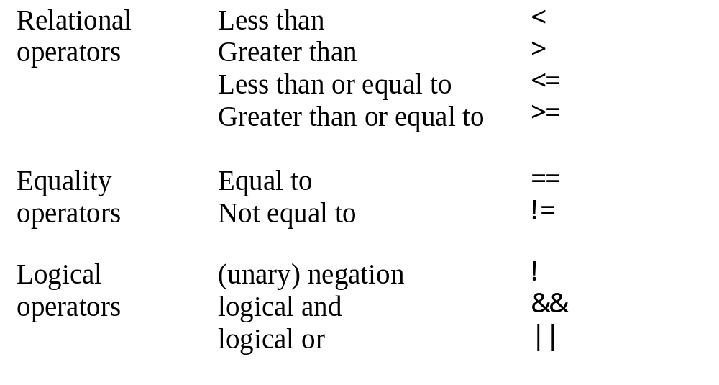
Relational, Equality, and Logical Operators

Slide 22
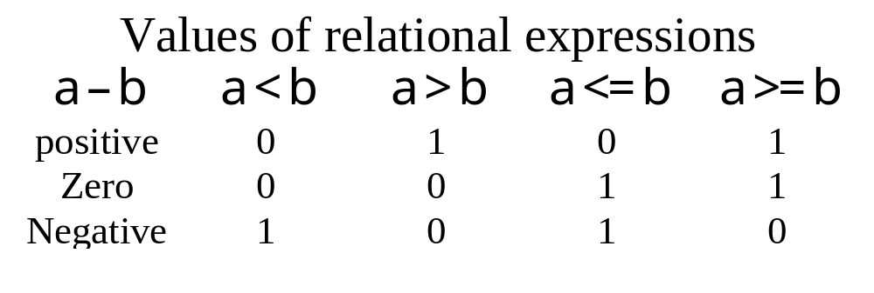
Relational Operators
Relational operators take expressions as operands and evaluate to type int. They will always evaluate to either 1 (true), or 0 (false).
Because relational operators compare values, they are always binary operators.

Slide 23
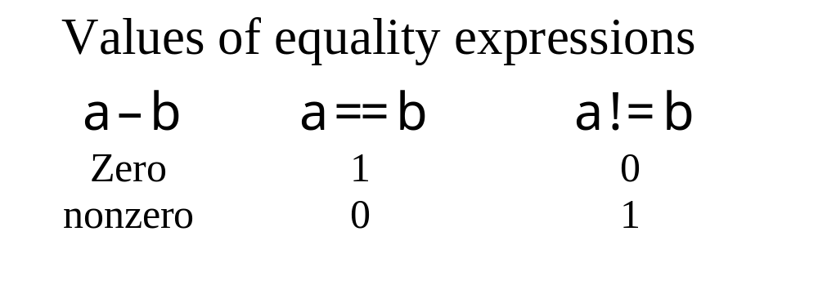
Equality Operators
Equality operators take expressions as operands and evaluate to type int. They will always evaluate to either 1 (true), or 0 (false).
Because equality operators compare values, they are always binary operators.

Slide 24
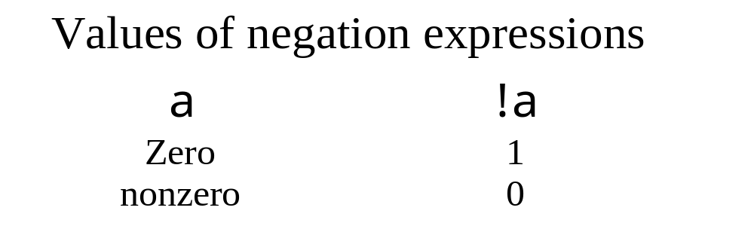
Logical Operators
The logical operator ! is called the negation operator. It is a unary operand because it has one operand.
Don’t confuse negation with unary minus.
    !!a is not the same as a. !!5 = !(!5) = !(0) = 1

Slide 25
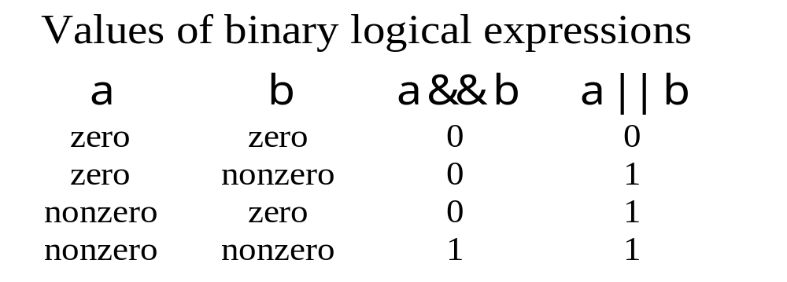
Binary logical Operators
The binary logical operators && and || act on pairs of expressions and has value of type int with a value of 0 or 1.

Slide 26
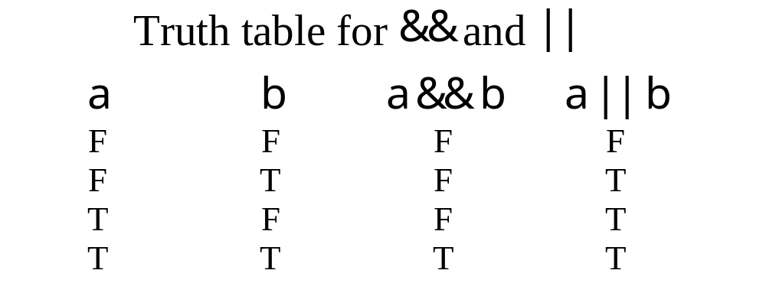
More about binary logical Operators
It’s easiest to think of these as being true when either a and b are true(&&) or when either a or b or both are true(||). Note: whitespace is important in these as in other multicharacter operators.

Slide 27
Short-Circuit Evaluation
An expression containing && or || is evaluated according to the rules of precedence and associativity. The evaluation stops as soon as the value is known. So if the operands contain expressions with side-effects, they may or may not be performed. Rule of thumb: try to avoid side effects when writing operands of these operators.

Slide 28
Short Circuit Examples
int i, j;
i = 2 && (j = 2);
printf (“%d %d\n”, i, j); /* 1 2 is printed */
(i = 0) && (j = 3);
printf (“%d %d\n”, i, j); /* 0 2 is printed */
i = 0 || ( j = 4);
printf (“%d %d\n”, i, j); /* 1 4 is printed */
( i = 2 ) || ( j = 5 );
printf (“%d %d\n”, i, j); /* 2 4 is printed */
Notes:
Statement

Slide 29
The conditional operator
expr1 ? expr2 : expr3
expr1 is first evaluated. If expr1 is nonzero, then expr2 is evaluated and the whole expression has that value, otherwise expr3 is evaluated and the whole expression has its value.
The conditional operator, ?: is called a ternary operator because it takes three operands. It is a two-character operator but the characters are not written consecutively, rather they separate the operands.
Except for the resulting value of the statement, you could use an if-else statement as shown:
if (expr1)
expr2;
else
expr3;

Slide 30
The comma operator
expr1 , expr2
The value of expr1 is calculated then the value of expr2 is calculated the value of (expr1 , expr2) is just the value of expr2.
int i, j, k =3, m;
double x = 3.3;
m = (i = 1, j=2, ++k +1); /* m will be 5 */
m = (k != 7, ++ x * 2.0 +1); /* m will be 9.6 */

Slide 31
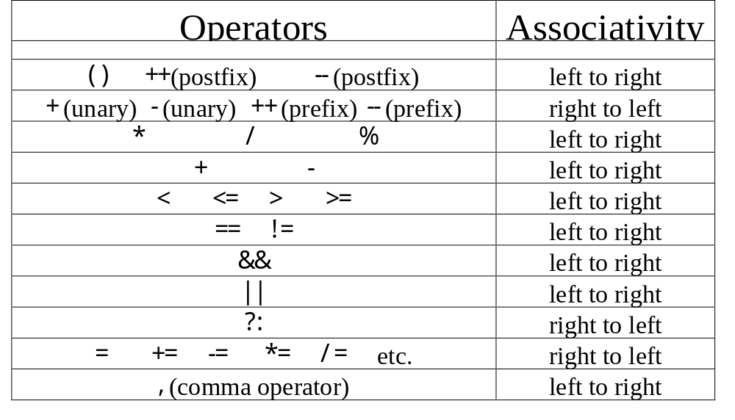
Operator precedence and associativity

Slide 32
Compound Statements
In C, a group of statements can be used where the rules call for a single statement. This is done by enclosing the group of statements in braces, i.e. the symbols { and }. The group of statements is called a block.
You have been writing blocks without knowing it, your main function is a block.
By the way, within a block you can declare new variables that are local to the block. All the variables in your programs are local to the block for your function main.

Slide 33
Empty Statements
If the syntax says you should use a statement, but you don’t require any action, you use the empty statement. The empty statement is the single semicolon.
Sometimes when nesting if statements this is used to match an outer else statement to an outer if statement. (Don’t panic, example coming…)

Slide 34
Empty statement example
if (a == 4)
if (b == 7)
printf (“a is 4 and b is 7\n”);
else;
else
printf(“a is not 4\n”);
In the above example, we have a nested if statement. Remember, an statement looks like this:
  if (expr) statement1
  If statement1 is itself an if statement, then it is called a nested if statement. In nested if statements, an else will match the innermost if. Without the empty statement following the first else, whenever a is 4 and b is not 7 the message would be “a is not 4”. It is sometimes much clearer to use the empty statement, even if there is a way to code without it, as could be done here by checking b first and then a.

Slide 35
Example: Find the minimum of three values
Pseudo-code:
  Initialize:
  Process:
  Read three values into x, y, and z.
  if (x < y)
  min = x
  else
  min = y
  if (z < min)
  min = z
  print min

Slide 36
Program to find minimum of three values
int main(void)
{
int x, y, z, min;
printf(“Input three integers: “);
scanf(“%d%d%d”, &x, &y, &z);
if (x < y)
min = x;
else
min = y;
if (z < min)
min = z;
printf(“The minimum value is %d\n”, min);
return 0;
}

Slide 37
Finding Maximum Values
Pseudo-code:
  Initialize:
  cnt = 0
  Process:
  Prompt user for number of values
  Read number of values into n
  while n <= 0
  Prompt user for positive number of values
  Read number of values into n
  Prompt the user to enter n real numbers
  Read a number into x
  max = x
  cnt = cnt + 1
  while cnt < n
  Read a number into x
  if max < x
  max = x
  output max

Slide 38
Finding maximum values program
int main(void)
{
int cnt = 0, n; float max, x;
printf (“The maximum value will be computed.\n”);
printf (“How many numbers do you wish to enter? “);
scanf (“%d”, \n);
/* The error checking is shown on the next slide (program in text is too big for slide.) */
printf(“\nEnter %d real numbers: “, n);
scanf (“%f”, &x);
max = x;
while (++cnt < n) {
scanf (“%f”, &x);
if (max < x)
max = x;
}
printf(“\nMaximum value: %g \n”, max);
return 0;
}

Slide 39
Error Checking in find_max program
This is a common way to handle user errors, the data is checked for valid values, if it is invalid, an error message is printed and the input prompt is repeated. Since the user can make mistakes again and again, a looping construct is used to ensure the reading, checking, and prompting are repeated until a valid value is used.
scanf (“%d”, &n); /* Read number of values into n */
while (n <= 0) {
printf(“\nERROR: Positive integer required. \n\n”);
printf(“How many numbers do you wish to enter? “);
scanf(“%d”, &n);
}

Slide 40
find_max program “primes the pump”
Notice that the find_max program does the scanf for the first value and assigns it to the identifier max, before it enters the loop. This is done because the value max needs to have its initial value set before it can be tested. (What would happen if we wrote the following?
printf(“\nEnter %d real numbers: “, n);
while (cnt++ < n) {
scanf (“%f”, &x);
if (max < x)
max = x;
}

Slide 41
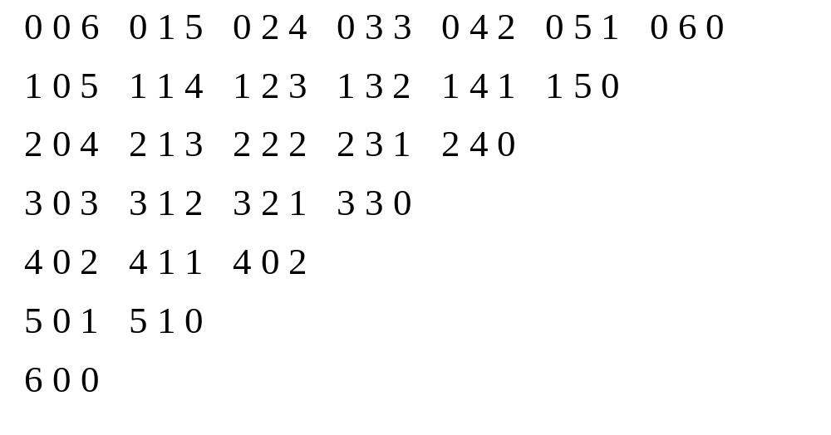
Combinatorics
List all triple of nonnegative numbers that add up to a given number.
Example: Numbers adding to 6:
There are 24 such triples

Slide 42
Listing Triples for 7 Pseudocode
Initialize:
i=0, j=0, k=0, cnt=0, N=7
Process:
while ( i <= N)
while (j <= N)
while (k <= N)
if i+j+k=N
print i, j, k
count = count +1
endif
k = k + 1
endwhile
j = j + 1
endwhile
i = i + 1
endwhile

Slide 43
add_to_n program
/* Find triples of integers that add up to N. */
#include <stdio.h>
#define N 7
int main(void)
{
int cnt =0, i, j, k, n;
for ( i = 0; i <= N; ++i )
for ( j = 0; j <= N; ++j )
for ( k = 0; k <= N; ++k )
if ( i + j + k == N ){
++ cnt;
printf(“%3d%3d%3d\n”, i, j, k);
}
printf (“\nCount: %d\n”, cnt);
return 0;
}

Slide 44
Improved add_to_n program pseudocode
Initialize:
i=0, j=0, k=0, cnt=0, N=7
Process:
while ( i <= N)
j = 0
while (j <= N - i)
k = N - i - j
print i, j, k
count = count +1
j = j + 1
endwhile
i = i + 1
endwhile

Slide 45
Improved add_to_n program
/* Find triples of integers that add up to N. */
#include <stdio.h>
#define N 7
int main(void)
{
int cnt =0, i, j, k, n;
for ( i = 0; i <= N; ++i )
for ( j = 0; j <= N - i; ++j ){
k = N - i - j;
++ cnt;
printf(“%3d%3d%3d\n”, i, j, k);
}
printf (“\nCount: %d\n”, cnt);
return 0;
}

Slide 46
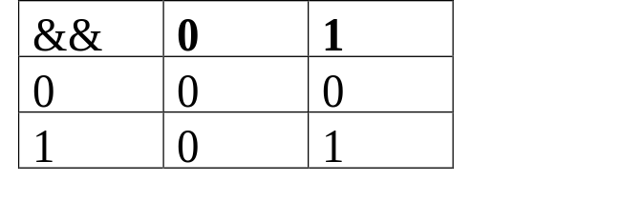
Boolean Variables
Boolean variables are variables that take on values of 0 or 1. The value 0 “means false”, while 1 “means true”.
A truth table lists for all combinations of inputs what the result of an operation is. In a very real sense, a truth table defines an operation. (It tells you everything there is to know about the operation except precedence and associativity.)
  Truth tables are to boolean variables and their operators as addition tables are to integers and the addition operator.
For binary operators there are only 16 possible truth tables, thus there are only 16 possible unique binary operators.
Example: Truth Table for &&
Truth tables can likewise be used to express the outputs of general functions.

Slide 47
Example: Print Some boolean truth tables
Given 5 binary variables, b1, b2, b3, b4, b5, we want to produce truth tables for
  b1 || b3 || b5
  b1 && b2 || b4 && b5
  the majority function. This returns 1 if the majority of its inputs have the value 1.

Slide 48
PseudoCode
Initialize:
Process:
print headings
for b1 = 0 to 1
for b2 = 0 to 1
for b3 = 0 to 1
for b4 = 0 to 1
for b5 = 0 to 1
output b1, b2, b3, b4, b5,
b1 || b3 || b5,
b1 && b2 || b4 && b5,
b1 + b2 +b3 + b4+ b5 >= 3
endfor
endfor
endfor
endfor
endfor

Slide 49
Boolean Variables C program
#include <stdio.h>
int main(void){
int b1, b2, b3, b4, b5; /* boolean variables */
int cnt = 0;
printf(“\n%5s%5s%5s%5s%5s%5s%7s%7s%11s\n\n”, /* headings */
“Cnt”, “b1”, “b2”, “b3”, “b4”, “b5”,
“fct1”, “fct2”, “majority”);
for ( b1 = 0; b1 <= 1; ++b1)
for ( b2 = 0; b2 <= 1; ++b2)
for ( b3 = 0; b3 <= 1; ++b3)
for ( b4 = 0; b4 <= 1; ++b4)
for ( b5 = 0; b5 <= 1; ++b5)
printf(“\n%5d%5d%5d%5d%5d%5d%6d%7d%9d\n\n”, ++cnt, b1, b2, b3, b4, b5,
b1 || b3 || b5,
b1 && b2 || b4 && b5,
b1 + b2 +b3 + b4+ b5 >= 3);
printf(“\n”);
return 0;
}

Slide 50
Boolean variables: sample output
Cnt b1 b2 b3 b4 b5 fct1 fct2 majority
1 0 0 0 0 0 0 0 0
2 0 0 0 0 1 1 0 0
3 0 0 0 1 0 0 0 0
4 0 0 0 1 1 1 1 0
5 0 0 1 0 0 1 0 0
6 0 0 1 0 1 1 0 0
7 0 0 1 1 0 1 0 0
8 0 0 1 1 1 1 1 1
9 0 1 0 0 0 0 0 0
10 0 1 0 0 1 1 0 0
11 0 1 0 1 0 0 0 0
12 0 1 0 1 1 1 1 1
13 0 1 1 0 0 1 0 0
14 0 1 1 0 1 1 0 1
15 0 1 1 1 0 1 0 1
16 0 1 1 1 1 1 1 1

Slide 51
Common Programming Errors
Inadvertent use of = instead of ==
“Unwanted” infinite loop
  printf(“Input an integer: “);
  scanf(“%d”, &n);
  while (--n) { /* Loops “forever” if n is 0 or negative*/
Empty statements in for loops:
  for ( j = 1; j <= 10; ++j );
    sum += j; /* Sum will be 11 when done */
( 3 > 2 > 1)
  In everyday life this is true as all grade school students know.
  In C, it is not true, first 3 > 2 is evaluated, the equivalent expression is
    1 > 1. And, of course, 1 > 1 is false.

Slide 52
Common errors: Using floats as loop counters
#include <stdio.h>
int main(void){
float v1=0.400001, v2=6.400001, x;
for (x = v1; x != v2; x++) printf("x = %f\n",x);
return 0;
}
x = 0.400001
x = 1.400001
x = 2.400001
x = 3.400001
x = 4.400001
x = 5.400001
x = 6.400001
x = 7.400001
x = 8.400002
x = 9.400002

Slide 53
Chapter 3 Review
Relational, equality and logical expressions have integer values of 0 or 1.
Compound statements i.e. statements between { and }
if statements, if-else statements, dangling else problem solved with empty statements.
while, for and do loops are used to control the repeated execution of (compound) statements.
Learn the operator precedence and associativity table (Guaranteed exam questions…)
Control flow can be transferred unconditionally using goto, break, continue, return.
Break statements end the innermost loop completely (unless in a switch statement), Continue statements continue with the next iteration.
Goto’s are frowned on in this course and most programming environments.
Switch statements can be used to make case studies easy to read.
The conditional operator can simplify writing if-else statements when the conditionally executed statements are not compound.

Slide 54
Exercise 26, page 120
The mathematical operation min(x,y) can be represented by the conditional expression
  (x < y) ? x : y
Describe the mathematical operations min( x, y, z ) and max( x, y, z, w) using only conditional expressions.
min( x, y, z)
  (x < y) ? (x < z) ? x : z : (y < z) ? y : z
max( x, y, z, w )
  Think of this as (w > z) ? max (x, y, w) : max (x, y, z)
    ( w > z ) ?( ( w > y )
    ? ( (x > w)? x : w)
    : ( (x > y) ? x : y) )
    : ( ( z > y )
    ? ( ( x > z ) ? x : z)
    : ( ( x > y ) ? x : y ) )
  Conclusion: you may want to think twice about overdoing use of ?:
Notes:
Remember this operator has right to left associativity.
Think of min (x,y, z) as (x< y) ? min(x, z) : min(y, z)
so we want to write ( x < y ) ? ( ( x < z ) ? x: z) : ( (y < z ) ? y : z ) )
The parenthesis are critical here, not just for understanding but also for the operations to occur in the order we want.
If we try to think of max(x,y,z,w) as max( max(x,y), max( z, w)) or even as
max(max(max(x,y),z),w) we have a problem. We will need to find max for some expression more than once! Easiest to think about this one conditional at a time: so
if (w > z) then max( x, y, w) else max (x, y, z)
in other words (w > z ) ? max( x, y, w ) : max( x, y, z)
changing the < to > in the above is how we write max(x, y, z) so we get:
( w > z ) ? ( ( w > y ) ? ( x > w) ? x: w) : ((x > y) ? x: w)) :
( ( x > y ) ? ( x > z) ? x:z) : ((x > y) ? x: y))
Note that parenthesis are used here to force every evaluation to be performed in the order we need them performed.
Hopefully, later we will see how to use the preprocessor to write such code both efficiently and clearly.

